Slide 1
CS162 Operating Systems and Systems Programming Lecture 5 Device Drivers, Sockets and IPC (Finished)
January 31st, 2023
Prof. John Kubiatowicz
http://cs162.eecs.Berkeley.edu

Slide 2
Recall: Low-Level File I/O: The RAW system-call interface
#include <fcntl.h>
#include <unistd.h>
#include <sys/types.h>
int open (const char *filename, int flags [, mode_t mode])
int creat (const char *filename, mode_t mode)
int close (int filedes)
Bit vector of:
Access modes (Rd, Wr, …)
Open Flags (Create, …)
Operating modes (Appends, …)
Bit vector of Permission Bits:
User|Group|Other X R|W|X
Integer return from open() is a file descriptor
Error indicated by return < 0: the global errno variable set with error (see man pages)
Operations on file descriptors:
Open system call created an open file description entry in system-wide table of open files
Open file description object in the kernel represents an instance of an open file
Why give user an integer instead of a pointer to the file description in kernel?

Slide 3
Recall: Example: lowio.c
int main() {
char buf[1000];
int fd = open("lowio.c", O_RDONLY, S_IRUSR | S_IWUSR);
if (fd < 0) { /* Error! errno variable contains specification of which error */
exit(1); }
ssize_t rd = read(fd, buf, sizeof(buf));
if (rd < 0) { /* Error! errno variable contains specification of which error */
exit(1); }
int err = close(fd);
/* check for errors */
ssize_t wr = write(STDOUT_FILENO, buf, rd);
/* check for errors */
}
How many bytes does this program read?

Slide 4
Low-Level I/O: Other Operations
Operations specific to terminals, devices, networking, …
e.g., ioctl
Duplicating descriptors
int dup2(int old, int new);
int dup(int old);
Pipes – channel
int pipe(int pipefd[2]);
Writes to pipefd[1] can be read from pipefd[0]
File Locking
Memory-Mapping Files
Asynchronous I/O

Slide 5
POSIX I/O: Design Patterns
Open before use
Access control check, setup happens here
Byte-oriented
Least common denominator
OS responsible for hiding the fact that real devices may not work this way (e.g. hard drive stores data in blocks)
Explicit close

Slide 6
POSIX I/O: Kernel Buffering
Reads are buffered inside kernel
Part of making everything byte-oriented
Process is blocked while waiting for device
Let other processes run while gathering result
Writes are buffered inside kernel
Complete in background (more later on)
Return to user when data is “handed off” to kernel
This buffering is part of global buffer management and caching for block devices (such as disks)
Items typically cached in quanta of disk block sizes
We will have many interesting things to say about this buffering when we dive into the kernel

Slide 7
Low-Level vs High-Level file API
Low-level direct use of syscall interface: open(), read(), write(), close()
Opening of file returns file descriptor: int myfile = open(…);
File descriptor only meaningful to kernel
Index into process (PDB) which holds pointers to kernel-level structure (“file description”) describing file.
Every read() or write() causes syscall no matter how small (could read a single byte)
Consider loop to get 4 bytes at a time using read():
Each iteration enters kernel for 4 bytes.
High-level buffered access: fopen(), fread(), fwrite(), fclose()
Opening of file returns ptr to FILE: FILE *myfile = fopen(…);
FILE structure is user space contains:
a chunk of memory for a buffer
the file descriptor for the file (fopen() will call open() automatically)
Every fread() or fwrite() filters through buffer and may not call read() or write() on every call.
Consider loop to get 4 bytes at a time using fread():
First call to fread() calls read() for block of bytes (say 1024). Puts in buffer and returns first 4 to user.
Subsequent fread() grab bytes from buffer

Slide 8
Low-Level vs. High-Level File API
Low-Level Operation:
High-Level Operation:
ssize_t read(…) {
};
ssize_t fread(…) {
};
Check buffer for contents
Return data to caller if available
asm code … syscall # into %eax
put args into registers %ebx, …
special trap instruction
asm code … syscall # into %eax
put args into registers %ebx, …
special trap instruction
Kernel:
Kernel:
get args from regs
dispatch to system func
Do the work to read from the file
Store return value in %eax
get args from regs
dispatch to system func
Do the work to read from the file
Store return value in %eax
get return values from regs
get return values from regs
Return data to caller
Update buffer with excess data
Return data to caller

Slide 9
High-Level vs. Low-Level File API
Streams are buffered in user memory: printf("Beginning of line ");
sleep(10); // sleep for 10 seconds
printf("and end of line\n");
Prints out everything at once
Operations on file descriptors are visible immediately
write(STDOUT_FILENO, "Beginning of line ", 18);
sleep(10);
write("and end of line \n", 16);
Outputs "Beginning of line" 10 seconds earlier than “and end of line”

Slide 10

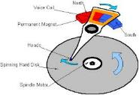




What’s below the surface ??
Application / Service
High Level I/O
streams
Low Level I/O
handles
Syscall
registers
File System
descriptions
I/O Driver
Commands and Data Transfers
Disks, Flash, Controllers, DMA

Slide 11
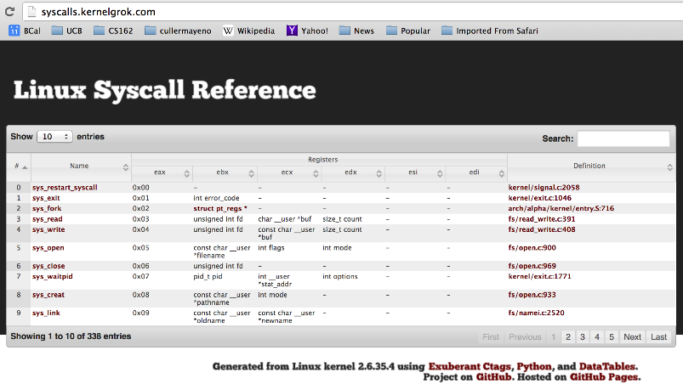
Recall: SYSCALL
Low level lib parameters are set up in registers and syscall instruction is issued
A type of synchronous exception that enters well-defined entry points into kernel

Slide 12
What’s below the surface ??
File descriptor number
- an int
Application / Service
High Level I/O
streams
Low Level I/O
handles
Syscall
registers
File System
descriptions
File description
a struct with all the info about the files
I/O Driver
Commands and Data Transfers
Disks, Flash, Controllers, DMA

Slide 13
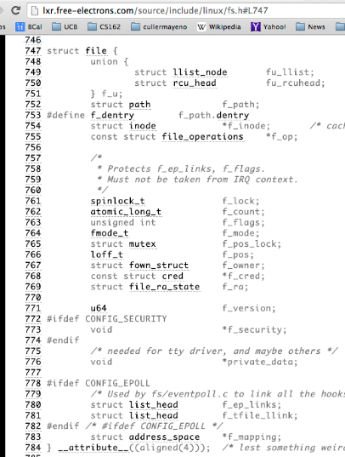
What’s in an Open File Description?
Inside Kernel!
For our purposes, the two most important things are:
Where to find the file data on disk
The current position within the file

Slide 14
File System: from syscall to driver
In fs/read_write.c
ssize_t vfs_read(struct file *file, char __user *buf, size_t count, loff_t *pos)
{
ssize_t ret;
if (!(file->f_mode & FMODE_READ)) return -EBADF;
if (!file->f_op || (!file->f_op->read && !file->f_op->aio_read))
return -EINVAL;
if (unlikely(!access_ok(VERIFY_WRITE, buf, count))) return -EFAULT;
ret = rw_verify_area(READ, file, pos, count);
if (ret >= 0) {
count = ret;
if (file->f_op->read)
ret = file->f_op->read(file, buf, count, pos);
else
ret = do_sync_read(file, buf, count, pos);
if (ret > 0) {
fsnotify_access(file->f_path.dentry);
add_rchar(current, ret);
}
inc_syscr(current);
}
return ret;
}
Read up to “count” bytes from “file” starting from “pos” into “buf”.
Return error or number of bytes read.

Slide 15
File System: from syscall to driver
In fs/read_write.c
ssize_t vfs_read(struct file *file, char __user *buf, size_t count, loff_t *pos)
{
ssize_t ret;
if (!(file->f_mode & FMODE_READ)) return -EBADF;
if (!file->f_op || (!file->f_op->read && !file->f_op->aio_read))
return -EINVAL;
if (unlikely(!access_ok(VERIFY_WRITE, buf, count))) return -EFAULT;
ret = rw_verify_area(READ, file, pos, count);
if (ret >= 0) {
count = ret;
if (file->f_op->read)
ret = file->f_op->read(file, buf, count, pos);
else
ret = do_sync_read(file, buf, count, pos);
if (ret > 0) {
fsnotify_access(file->f_path.dentry);
add_rchar(current, ret);
}
inc_syscr(current);
}
return ret;
}
Make sure we are allowed to read this file

Slide 16
File System: from syscall to driver
In fs/read_write.c
ssize_t vfs_read(struct file *file, char __user *buf, size_t count, loff_t *pos)
{
ssize_t ret;
if (!(file->f_mode & FMODE_READ)) return -EBADF;
if (!file->f_op || (!file->f_op->read && !file->f_op->aio_read))
return -EINVAL;
if (unlikely(!access_ok(VERIFY_WRITE, buf, count))) return -EFAULT;
ret = rw_verify_area(READ, file, pos, count);
if (ret >= 0) {
count = ret;
if (file->f_op->read)
ret = file->f_op->read(file, buf, count, pos);
else
ret = do_sync_read(file, buf, count, pos);
if (ret > 0) {
fsnotify_access(file->f_path.dentry);
add_rchar(current, ret);
}
inc_syscr(current);
}
return ret;
}
Check if file has read methods

Slide 17
File System: from syscall to driver
In fs/read_write.c
ssize_t vfs_read(struct file *file, char __user *buf, size_t count, loff_t *pos)
{
ssize_t ret;
if (!(file->f_mode & FMODE_READ)) return -EBADF;
if (!file->f_op || (!file->f_op->read && !file->f_op->aio_read))
return -EINVAL;
if (unlikely(!access_ok(VERIFY_WRITE, buf, count))) return -EFAULT;
ret = rw_verify_area(READ, file, pos, count);
if (ret >= 0) {
count = ret;
if (file->f_op->read)
ret = file->f_op->read(file, buf, count, pos);
else
ret = do_sync_read(file, buf, count, pos);
if (ret > 0) {
fsnotify_access(file->f_path.dentry);
add_rchar(current, ret);
}
inc_syscr(current);
}
return ret;
}
Check whether we can write to buf (e.g., buf is in the user space range)
unlikely(): hint to branch prediction this condition is unlikely

Slide 18
File System: from syscall to driver
In fs/read_write.c
ssize_t vfs_read(struct file *file, char __user *buf, size_t count, loff_t *pos)
{
ssize_t ret;
if (!(file->f_mode & FMODE_READ)) return -EBADF;
if (!file->f_op || (!file->f_op->read && !file->f_op->aio_read))
return -EINVAL;
if (unlikely(!access_ok(VERIFY_WRITE, buf, count))) return -EFAULT;
ret = rw_verify_area(READ, file, pos, count);
if (ret >= 0) {
count = ret;
if (file->f_op->read)
ret = file->f_op->read(file, buf, count, pos);
else
ret = do_sync_read(file, buf, count, pos);
if (ret > 0) {
fsnotify_access(file->f_path.dentry);
add_rchar(current, ret);
}
inc_syscr(current);
}
return ret;
}
Check whether we read from a valid range in the file.

Slide 19
File System: from syscall to driver
In fs/read_write.c
ssize_t vfs_read(struct file *file, char __user *buf, size_t count, loff_t *pos)
{
ssize_t ret;
if (!(file->f_mode & FMODE_READ)) return -EBADF;
if (!file->f_op || (!file->f_op->read && !file->f_op->aio_read))
return -EINVAL;
if (unlikely(!access_ok(VERIFY_WRITE, buf, count))) return -EFAULT;
ret = rw_verify_area(READ, file, pos, count);
if (ret >= 0) {
count = ret;
if (file->f_op->read)
ret = file->f_op->read(file, buf, count, pos);
else
ret = do_sync_read(file, buf, count, pos);
if (ret > 0) {
fsnotify_access(file->f_path.dentry);
add_rchar(current, ret);
}
inc_syscr(current);
}
return ret;
}
If driver provide a read function (f_op->read) use it; otherwise use do_sync_read()

Slide 20
File System: from syscall to driver
In fs/read_write.c
ssize_t vfs_read(struct file *file, char __user *buf, size_t count, loff_t *pos)
{
ssize_t ret;
if (!(file->f_mode & FMODE_READ)) return -EBADF;
if (!file->f_op || (!file->f_op->read && !file->f_op->aio_read))
return -EINVAL;
if (unlikely(!access_ok(VERIFY_WRITE, buf, count))) return -EFAULT;
ret = rw_verify_area(READ, file, pos, count);
if (ret >= 0) {
count = ret;
if (file->f_op->read)
ret = file->f_op->read(file, buf, count, pos);
else
ret = do_sync_read(file, buf, count, pos);
if (ret > 0) {
fsnotify_access(file->f_path.dentry);
add_rchar(current, ret);
}
inc_syscr(current);
}
return ret;
}
Notify the parent of this file that the file was read (see http://www.fieldses.org/~bfields/kernel/vfs.txt)

Slide 21
File System: from syscall to driver
In fs/read_write.c
ssize_t vfs_read(struct file *file, char __user *buf, size_t count, loff_t *pos)
{
ssize_t ret;
if (!(file->f_mode & FMODE_READ)) return -EBADF;
if (!file->f_op || (!file->f_op->read && !file->f_op->aio_read))
return -EINVAL;
if (unlikely(!access_ok(VERIFY_WRITE, buf, count))) return -EFAULT;
ret = rw_verify_area(READ, file, pos, count);
if (ret >= 0) {
count = ret;
if (file->f_op->read)
ret = file->f_op->read(file, buf, count, pos);
else
ret = do_sync_read(file, buf, count, pos);
if (ret > 0) {
fsnotify_access(file->f_path.dentry);
add_rchar(current, ret);
}
inc_syscr(current);
}
return ret;
}
Update the number of bytes read by “current” task (for scheduling purposes)

Slide 22
File System: from syscall to driver
In fs/read_write.c
ssize_t vfs_read(struct file *file, char __user *buf, size_t count, loff_t *pos)
{
ssize_t ret;
if (!(file->f_mode & FMODE_READ)) return -EBADF;
if (!file->f_op || (!file->f_op->read && !file->f_op->aio_read))
return -EINVAL;
if (unlikely(!access_ok(VERIFY_WRITE, buf, count))) return -EFAULT;
ret = rw_verify_area(READ, file, pos, count);
if (ret >= 0) {
count = ret;
if (file->f_op->read)
ret = file->f_op->read(file, buf, count, pos);
else
ret = do_sync_read(file, buf, count, pos);
if (ret > 0) {
fsnotify_access(file->f_path.dentry);
add_rchar(current, ret);
}
inc_syscr(current);
}
return ret;
}
Update the number of read syscalls by “current” task (for scheduling purposes)

Slide 23
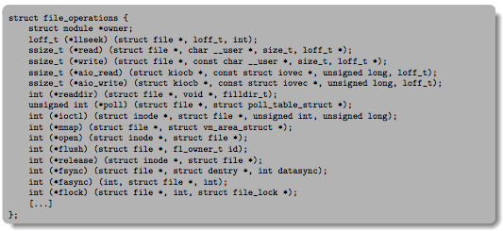
Lower Level Driver
Associated with particular hardware device
Registers / Unregisters itself with the kernel
Handler functions for each of the file operations

Slide 24
Device Drivers
Device Driver: Device-specific code in the kernel that interacts directly with the device hardware
Supports a standard, internal interface
Same kernel I/O system can interact easily with different device drivers
Special device-specific configuration supported with the ioctl() system call
Device Drivers typically divided into two pieces:
Top half: accessed in call path from system calls
implements a set of standard, cross-device calls like open(), close(), read(), write(), ioctl(), strategy()
This is the kernel’s interface to the device driver
Top half will start I/O to device, may put thread to sleep until finished
Bottom half: run as interrupt routine
Gets input or transfers next block of output
May wake sleeping threads if I/O now complete

Slide 25
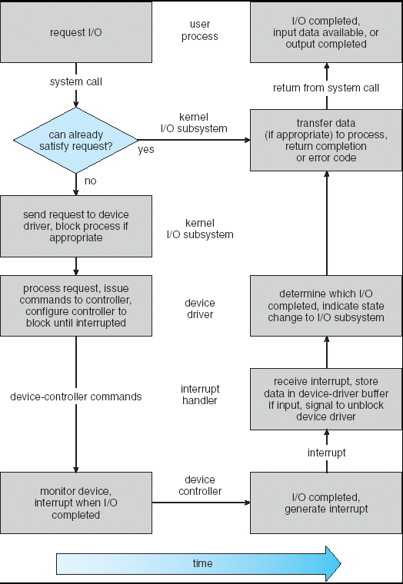
Life Cycle of An I/O Request
User
Program
Kernel I/O
Subsystem
Device Driver
Top Half
Device Driver
Bottom Half
Device
Hardware

Slide 26
Administrivia
Kubiatowicz Office Hours:
2-3pm, Monday & Wednesday
Friday was drop deadline. If you forgot to drop, we can’t help you!
You need to speak with advisor services in your department about how to drop
Recommendation: Read assigned readings before lecture
Group sign up should have happened already
If you don’t have 4 members in your group, we will try to find you other partners
Want everyone in your group to have the same TA
Go to your assigned section on Friday, starting this week!
Midterm 1 conflicts
Watch for announcements on EdStem (remember: MT1 is 2/16)

Slide 27
Communication between processes
Can we view files as communication channels?
Producer and Consumer of a file may be distinct processes
May be separated in time (or not)
However, what if data written once and consumed once?
Don’t we want something more like a queue?
Can still look like File I/O!
write(wfd, wbuf, wlen);
n = read(rfd,rbuf,rmax);

Slide 28
Communication Across the world looks like file IO!
write(wfd, wbuf, wlen);
n = read(rfd,rbuf,rmax);
Connected queues over the Internet
But what’s the analog of open?
What is the namespace?
How are they connected in time?

Slide 29
Request Response Protocol
Client (issues requests)
Server (performs operations)
write(rqfd, rqbuf, buflen);
requests
n = read(rfd,rbuf,rmax);
wait
service request
write(wfd, respbuf, len);
responses
n = read(resfd,resbuf,resmax);

Slide 30
Request Response Protocol: Across Network
Client (issues requests)
Server (performs operations)
write(rqfd, rqbuf, buflen);
requests
n = read(rfd,rbuf,rmax);
wait
service request
write(wfd, respbuf, len);
responses
n = read(resfd,resbuf,resmax);

Slide 31
The Socket Abstraction: Endpoint for Communication
Key Idea: Communication across the world looks like File I/O
Sockets: Endpoint for Communication
Queues to temporarily hold results
Connection: Two Sockets Connected Over the network ⇒ IPC over network!
How to open()?
What is the namespace?
How are they connected in time?
write(wfd, wbuf, wlen);
Process
Socket
Socket
Process
n = read(rfd, rbuf, rmax);

Slide 32
Sockets: More Details
Socket: An abstraction for one endpoint of a network connection
Another mechanism for inter-process communication
Most operating systems (Linux, Mac OS X, Windows) provide this, even if they don’t copy rest of UNIX I/O
Standardized by POSIX
First introduced in 4.2 BSD (Berkeley Standard Distribution) Unix
This release had some huge benefits (and excitement from potential users)
Runners waiting at release time to get release on tape and take to businesses
Same abstraction for any kind of network
Local (within same machine)
The Internet (TCP/IP, UDP/IP)
Things “no one” uses anymore (OSI, Appletalk, IPX, …)

Slide 33
Sockets: More Details
Looks just like a file with a file descriptor
Corresponds to a network connection (two queues)
write adds to output queue (queue of data destined for other side)
read removes from it input queue (queue of data destined for this side)
Some operations do not work, e.g. lseek
How can we use sockets to support real applications?
A bidirectional byte stream isn’t useful on its own…
May need messaging facility to partition stream into chunks
May need RPC facility to translate one environment to another and provide the abstraction of a function call over the network

Slide 34


Simple Example: Echo Server
“hello, world”
“hello, world”
Client
Web Server

Slide 35


Simple Example: Echo Server
Client (issues requests)
Server (services requests)
fgets(sndbuf,bufsize,stdin);
write(sockfd,sndbuf,strlen(sndbuf)+1);
n = read(sockfd,reqbuf,…);
wait
n = read(sockfd,rcvbuf, …);
Server
Socket
print
Client
Socket
wait
write(sockfd,reqbuf,…);
print

Slide 36
Echo client-server example
void client(int sockfd) {
int n;
char sndbuf[MAXIN]; char rcvbuf[MAXOUT];
while (1) {
fgets(sndbuf,MAXIN,stdin); /* prompt */
write(sockfd, sndbuf, strlen(sndbuf)+1); /* send (including null terminator) */
memset(rcvbuf,0,MAXOUT); /* clear */
n=read(sockfd, rcvbuf, MAXOUT); /* receive */
write(STDOUT_FILENO, rcvbuf, n); /* echo */
}
void server(int consockfd) {
char reqbuf[MAXREQ];
int n;
while (1) {
memset(reqbuf,0, MAXREQ);
n = read(consockfd,reqbuf,MAXREQ); /* Recv */
if (n <= 0) return;
write(STDOUT_FILENO, reqbuf, n);
write(consockfd, reqbuf, n); /* echo*/
}
}

Slide 37
What Assumptions are we Making?
Reliable
Write to a file => Read it back. Nothing is lost.
Write to a (TCP) socket => Read from the other side, same.
In order (sequential stream)
Write X then write Y => read gets X then read gets Y
When ready?
File read gets whatever is there at the time
Actually need to loop and read until we receive the terminator (‘\0’)
Assumes writing already took place
Blocks if nothing has arrived yet

Slide 38
Socket Creation
File systems provide a collection of permanent objects in a structured name space:
Processes open, read/write/close them
Files exist independently of processes
Easy to name what file to open()
Pipes: one-way communication between processes on same (physical) machine
Single queue
Created transiently by a call to pipe()
Passed from parent to children (descriptors inherited from parent process)
Sockets: two-way communication between processes on same or different machine
Two queues (one in each direction)
Processes can be on separate machines: no common ancestor
How do we name the objects we are opening?
How do these completely independent programs know that the other wants to “talk” to them?

Slide 39
Namespaces for Communication over IP
Hostname
www.eecs.berkeley.edu
IP address
128.32.244.172 (IPv4, 32-bit Integer)
2607:f140:0:81::f (IPv6, 128-bit Integer)
Port Number
0-1023 are “well known” or “system” ports
Superuser privileges to bind to one
1024 – 49151 are “registered” ports (registry)
Assigned by IANA for specific services
49152–65535 (2¹⁵+2¹⁴ to 2¹⁶−1) are “dynamic” or “private”
Automatically allocated as “ephemeral ports”

Slide 40
Connection Setup over TCP/IP
Client Side
Server Side
Server
Socket
Server Listening:
Server IP addr
well-known port,
Protocol (TCP/IP)
Connection request:
Client IP addr
Client Port
Protocol (TCP/IP)
Request Connection
new
socket
socket
socket
connection
Special kind of socket: server socket
Has file descriptor
Can’t read or write
Two operations:
listen(): Start allowing clients to connect
accept(): Create a new socket for a particular client

Slide 41
Connection Setup over TCP/IP
Client Side
Server Side
Server
Socket
Server Listening:
Server IP addr
well-known port,
Protocol (TCP/IP)
Connection request:
Client IP addr
Client Port
Protocol (TCP/IP)
Request Connection
new
socket
socket
socket
connection
5-Tuple identifies each connection:
Source IP Address
Destination IP Address
Source Port Number
Destination Port Number
Protocol (always TCP here)
Often, Client Port “randomly” assigned
Done by OS during client socket setup
Server Port often “well known”
80 (web), 443 (secure web), 25 (sendmail), etc
Well-known ports from 0—1023

Slide 42
Web Server
Request
Reply
Client
Web Server

Slide 43
Client-Server Models
Client 1
Client 2
Server
***
Client n
File servers, web, FTP, Databases, …
Many clients accessing a common server

Slide 44
Sockets in concept
Client
Server
Create Server Socket
Create Client Socket
Bind it to an Address
(host:port)
Connect it to server (host:port)
Listen for Connection
Accept syscall()
Connection Socket
Connection Socket
write request
read request
read response
write response
Close Client Socket
Close Connection Socket
Close Server Socket

Slide 45
Client Protocol
char *host_name, *port_name;
// Create a socket
struct addrinfo *server = lookup_host(host_name, port_name);
int sock_fd = socket(server->ai_family, server->ai_socktype,
server->ai_protocol);
// Connect to specified host and port
connect(sock_fd, server->ai_addr, server->ai_addrlen);
// Carry out Client-Server protocol
run_client(sock_fd);
/* Clean up on termination */
close(sock_fd);
char *host_name, *port_name;
// Create a socket
struct addrinfo *server = lookup_host(host_name, port_name);
int sock_fd = socket(server->ai_family, server->ai_socktype,
server->ai_protocol);
// Connect to specified host and port
connect(sock_fd, server->ai_addr, server->ai_addrlen);
// Carry out Client-Server protocol
run_client(sock_fd);
/* Clean up on termination */
close(sock_fd);

Slide 46
Client-Side: Getting the Server Address
struct addrinfo *lookup_host(char *host_name, char *port) {
struct addrinfo *server;
struct addrinfo hints;
memset(&hints, 0, sizeof(hints));
hints.ai_family = AF_UNSPEC; /* Includes AF_INET and AF_INET6 */
hints.ai_socktype = SOCK_STREAM; /* Essentially TCP/IP */
int rv = getaddrinfo(host_name, port_name,
&hints, &server);
if (rv != 0) {
printf("getaddrinfo failed: %s\n", gai_strerror(rv));
return NULL;
}
return server;
}

Slide 47
Server Protocol (v1)
// Create socket to listen for client connections
char *port_name;
struct addrinfo *server = setup_address(port_name);
int server_socket = socket(server->ai_family, server->ai_socktype, server->ai_protocol);
// Bind socket to specific port
bind(server_socket, server->ai_addr, server->ai_addrlen);
// Start listening for new client connections
listen(server_socket, MAX_QUEUE);
while (1) {
// Accept a new client connection, obtaining a new socket
int conn_socket = accept(server_socket, NULL, NULL);
serve_client(conn_socket);
close(conn_socket);
}
close(server_socket);
// Create socket to listen for client connections
char *port_name;
struct addrinfo *server = setup_address(port_name);
int server_socket = socket(server->ai_family, server->ai_socktype, server->ai_protocol);
// Bind socket to specific port
bind(server_socket, server->ai_addr, server->ai_addrlen);
// Start listening for new client connections
listen(server_socket, MAX_QUEUE);
while (1) {
// Accept a new client connection, obtaining a new socket
int conn_socket = accept(server_socket, NULL, NULL);
serve_client(conn_socket);
close(conn_socket);
}
close(server_socket);

Slide 48
Server Address: Itself (wildcard IP), Passive
struct addrinfo *setup_address(char *port) {
struct addrinfo *server;
struct addrinfo hints;
memset(&hints, 0, sizeof(hints));
hints.ai_family = AF_UNSPEC; /* Includes AF_INET and AF_INET6 */
hints.ai_socktype = SOCK_STREAM; /* Essentially TCP/IP */
hints.ai_flags = AI_PASSIVE; /* Set up for server socket */
int rv = getaddrinfo(NULL, port, &hints, &server); /* No address! (any local IP) */
if (rv != 0) {
printf("getaddrinfo failed: %s\n", gai_strerror(rv));
return NULL;
}
return server;
}
Accepts any connections on the specified port

Slide 49
How Could the Server Protect Itself?
Handle each connection in a separate process
This will mean that the logic serving each request will be “sandboxed” away from the main server process
In the following code, keep in mind:
fork() will duplicate all of the parent’s file descriptors (i.e. pointers to sockets!)
We keep control over accepting new connections in the parent
New child connection for each remote client

Slide 50
Sockets With Protection (each connection has own process)
Client
Server
Create Server Socket
Create Client Socket
Bind it to an Address
(host:port)
Connect it to server (host:port)
Listen for Connection
Accept syscall()
Connection Socket
Connection Socket
Child
Parent
Close Listen Socket
Close Connection Socket
write request
read request
read response
write response
Wait for child
Close Client Socket
Close Connection Socket
Close Server Socket

Slide 51
Server Protocol (v2)
// Socket setup code elided…
listen(server_socket, MAX_QUEUE);
while (1) {
// Accept a new client connection, obtaining a new socket
int conn_socket = accept(server_socket, NULL, NULL);
pid_t pid = fork();
if (pid == 0) {
close(server_socket);
serve_client(conn_socket);
close(conn_socket);
exit(0);
} else {
close(conn_socket);
wait(NULL);
}
}
close(server_socket);
// Socket setup code elided…
listen(server_socket, MAX_QUEUE);
while (1) {
// Accept a new client connection, obtaining a new socket
int conn_socket = accept(server_socket, NULL, NULL);
pid_t pid = fork();
if (pid == 0) {
close(server_socket);
serve_client(conn_socket);
close(conn_socket);
exit(0);
} else {
close(conn_socket);
wait(NULL);
}
}
close(server_socket);

Slide 52
How to make a Concurrent Server
So far, in the server:
Listen will queue requests
Buffering present elsewhere
But server waits for each connection to terminate before servicing the next
This is the standard shell pattern
A concurrent server can handle and service a new connection before the previous client disconnects
Simple – just don’t wait in parent!
Perhaps not so simple – multiple child processes better not have data races with one another through file system/etc!

Slide 53
Sockets With Protection and Concurrency
Client
Server
Create Server Socket
Create Client Socket
Bind it to an Address
(host:port)
Connect it to server (host:port)
Listen for Connection
Accept syscall()
Connection Socket
Connection Socket
Child
Parent
Close Listen Socket
Close Connection Socket
write request
read request
read response
write response
Close Client Socket
Close Connection Socket
Close Server Socket

Slide 54
Server Protocol (v3)
// Socket setup code elided…
listen(server_socket, MAX_QUEUE);
while (1) {
// Accept a new client connection, obtaining a new socket
int conn_socket = accept(server_socket, NULL, NULL);
pid_t pid = fork();
if (pid == 0) {
close(server_socket);
serve_client(conn_socket);
close(conn_socket);
exit(0);
} else {
close(conn_socket);
//wait(NULL);
}
}
close(server_socket);
// Socket setup code elided…
listen(server_socket, MAX_QUEUE);
while (1) {
// Accept a new client connection, obtaining a new socket
int conn_socket = accept(server_socket, NULL, NULL);
pid_t pid = fork();
if (pid == 0) {
close(server_socket);
serve_client(conn_socket);
close(conn_socket);
exit(0);
} else {
close(conn_socket);
//wait(NULL);
}
}
close(server_socket);

Slide 55
Faster Concurrent Server (without Protection)
Spawn a new thread to handle each connection
Lower overhead spawning process (less to do)
Main thread initiates new client connections without waiting for previously spawned threads
Why give up the protection of separate processes?
More efficient to create new threads
More efficient to switch between threads
Even more potential for data races (need synchronization?)
Through shared memory structures
Through file system

Slide 56
Sockets with Concurrency, without Protection
Client
Server
Create Server Socket
Create Client Socket
Bind it to an Address
(host:port)
Connect it to server (host:port)
Listen for Connection
Accept syscall()
Connection Socket
Connection Socket
pthread_create
Spawned Thread
write request
read request
Main Thread
read response
write response
Close Client Socket
Close Connection Socket
Close Server Socket

Slide 57
Thread Pools: More Later!
Problem with previous version: Unbounded Threads
When web-site becomes too popular – throughput sinks
Instead, allocate a bounded “pool” of worker threads, representing the maximum level of multiprogramming
Master
Thread
queue
Thread Pool
master() { allocThreads(worker,queue); while(TRUE) { con=AcceptCon(); Enqueue(queue,con); wakeUp(queue); } }
worker(queue) { while(TRUE) { con=Dequeue(queue); if (con==null) sleepOn(queue); else ServiceWebPage(con); } }

Slide 58
Conclusion
Device Driver: Device-specific code in the kernel that interacts directly with the device hardware
Supports a standard, internal interface
Same kernel I/O system can interact easily with different device drivers
File abstraction works for inter-processes communication (local or Internet)
Socket: an abstraction of a network I/O queue (IPC mechanism)
Processes have two parts
One or more Threads (Concurrency)
Address Spaces (Protection)
Stack is an essential part of a computation stream
Every thread has a stack!

